Slide 1


Université Panthéon-Assas Master 2 Ingénierie Statistique et Financière
Insurance Econometrics
Multinomial logit Model
Joseph Lanfranchi, 2021-22

Slide 2
Introduction to dependency cover
In this second part devoted to econometric modelling of insurance choices, our goal will be to explain choices that are no more binary but contains at least three unordered categories of answers.
One way to deal with this type of modelling is to use the multinomial logit model. We will explore how to perform such technique using Sas to explain how the French households choose between various systems of dependency insurance.
Dependency insurance shall provide coverage for the costs sustained by individuals in order to perform the tasks of daily life.
Joseph Lanfranchi ISF 2020-21

Slide 3
Introduction to dependency cover
The topic of dependency is now extensively discussed by policy makers, journalists and insurance companies. Hence, the president Sarkozy proposed to add to the French social security system a fifth risk to protect people against dependency.
However parliamentary reports have highlighted the very large costs of public dependency insurance and how difficult it would be to finance such a project. Therefore the reform have been abandoned in 2012.
In 2020, Social Security will extend its interventions to dependency, which will become its fifth risk after old age, sickness (health, maternity, prevention), family (family allowances and related benefits) and occupational accidents and diseases.
At the very moment, multiple channels of dependent persons are financed by the State; among these the most important is the l’APA, “l’Allocation Personnalisée d’Autonomie” that amounts for 80% of the participation of the French departments, “l’Aide sociale à l’hébergement” (ASH) and “l’aide à domicile”.
Joseph Lanfranchi ISF 2020-21

Slide 4
Introduction to dependency cover
In this chapter, we will focus on the private supply of dependency insurance. Hence, households may chose to contract with private insurance companies and mutual funds or privately invest in risk management. (Hence, we will not consider the means of intra family and inter-generational solidarity).
Interrogation about the topic of dependency have been recently added to the questionnaire of the Pater Survey in 2011.
As a first step, the heads of households are questioned about their understanding or perception of the risk of dependency.
Then, this question acts as a filter and only those households who declared to consider the risk of dependency are further questioned about what steps have been taken on that matter.
Our modelling choice is to deal uniquely with this subpopulation that have been further questioned on their investment choices.
Joseph Lanfranchi ISF 2020-21

Slide 5
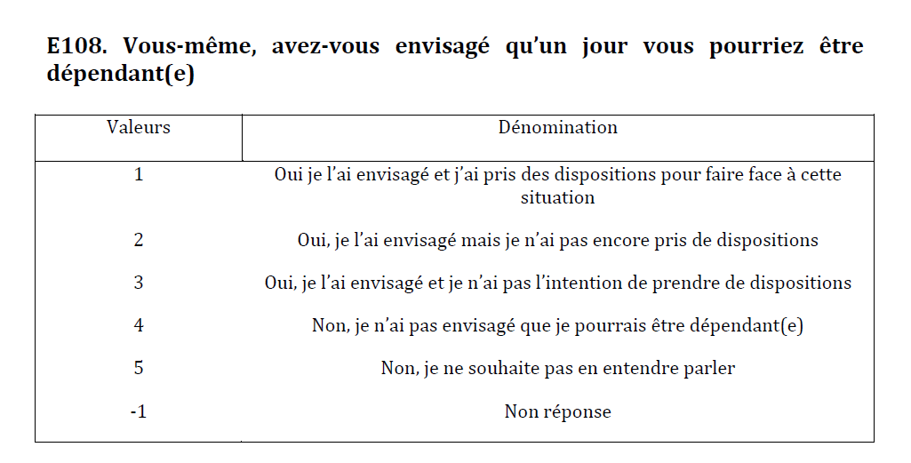

Slide 6
e108. Avez-vous envisagé qu’un jour vous pourriez être dépendant(e)?
e108 | Fréquence | Pourcentage | Fréquence cumulée | Pourcentage cumulé
-1 | 18 | 0.55 | 18 | 0.55
1 | 231 | 7.08 | 249 | 7.63
2 | 1236 | 37.86 | 1485 | 45.48
3 | 241 | 7.38 | 1726 | 52.86
4 | 1078 | 33.02 | 2804 | 85.88
5 | 461 | 14.12 | 3265 | 100.00
Fréquence manquante = 351

Slide 7
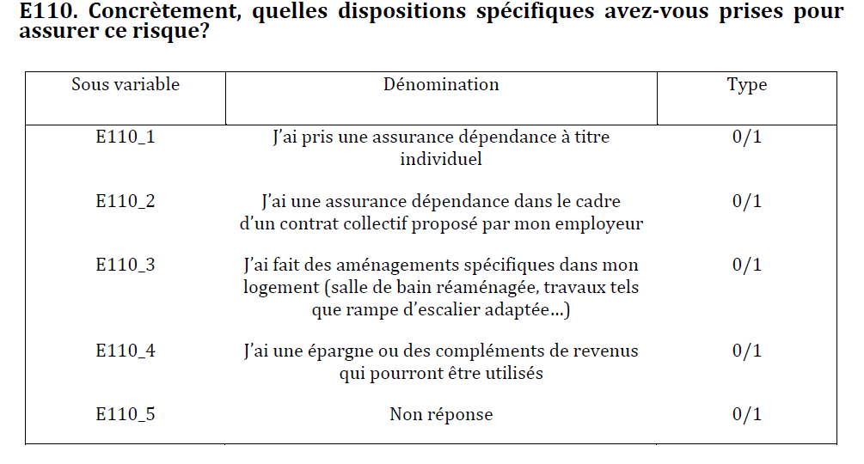
A dependency insurance contract may be underwritten individually or within the framework of a collective contract initiated by a corporate entity, generally a company for the benefit of its employees.
According to the choices offered to respondents, the choices of households have been coded in three unordered categories :
1. Dependency insurance contract (individual or collective)
2. Private investments and savings
3. The two forms of plans simultaneously.

Slide 8
e110_1.J’ai pris une assurance dépendance à titre individuel
e110_1 | Fréquence | Pourcentage | Fréquence cumulée | Pourcentage cumulé
0 | 78 | 33.77 | 78 | 33.77
1 | 153 | 66.23 | 231 | 100.00
Fréquence manquante = 3385
e110_2. J’ai une assurance dépendance dans le cadre d’un contrat collectif
e110_2 | Fréquence | Pourcentage | Fréquence cumulée | Pourcentage cumulé
0 | 205 | 88.74 | 205 | 88.74
1 | 26 | 11.26 | 231 | 100.00
Fréquence manquante = 3385
e110_3.J’ai fait des aménagements spécifiques dans mon logement
e110_3 | Fréquence | Pourcentage | Fréquence cumulée | Pourcentage cumulé
0 | 201 | 87.01 | 201 | 87.01
1 | 30 | 12.99 | 231 | 100.00
Fréquence manquante = 3385
e110_4.J’ai une épargne ou des compléments de revenus
e110_4 | Fréquence | Pourcentage | Fréquence cumulée | Pourcentage cumulé
0 | 161 | 69.70 | 161 | 69.70
1 | 70 | 30.30 | 231 | 100.00
Fréquence manquante = 3385

Slide 9
Multinomial logit Model
Multinomial logit regression model is designed to explain the choices of individuals between multiple unordered category or modality of a given variable.
In this chapter, we consider models for unordered categories where the explanatory variables are the characteristics of the individual, and his environment.
We will not deal with the conditional logit model where the explanatory variables include the characteristics of the choice options.
The name of the model has been chosen because the outcome variable is assumed to be distributed according to a multinomial distribution rather than a binomial distribution.
In our real study example, we will restrict the population to the households which have already made explicit choices to anticipate the situation of dependency.
We’ll deal with a somehow limited sample of study as we observe only 231 households out of 3616 which claim to have made plans about that matter.
Joseph Lanfranchi ISF 2021-22

Slide 10
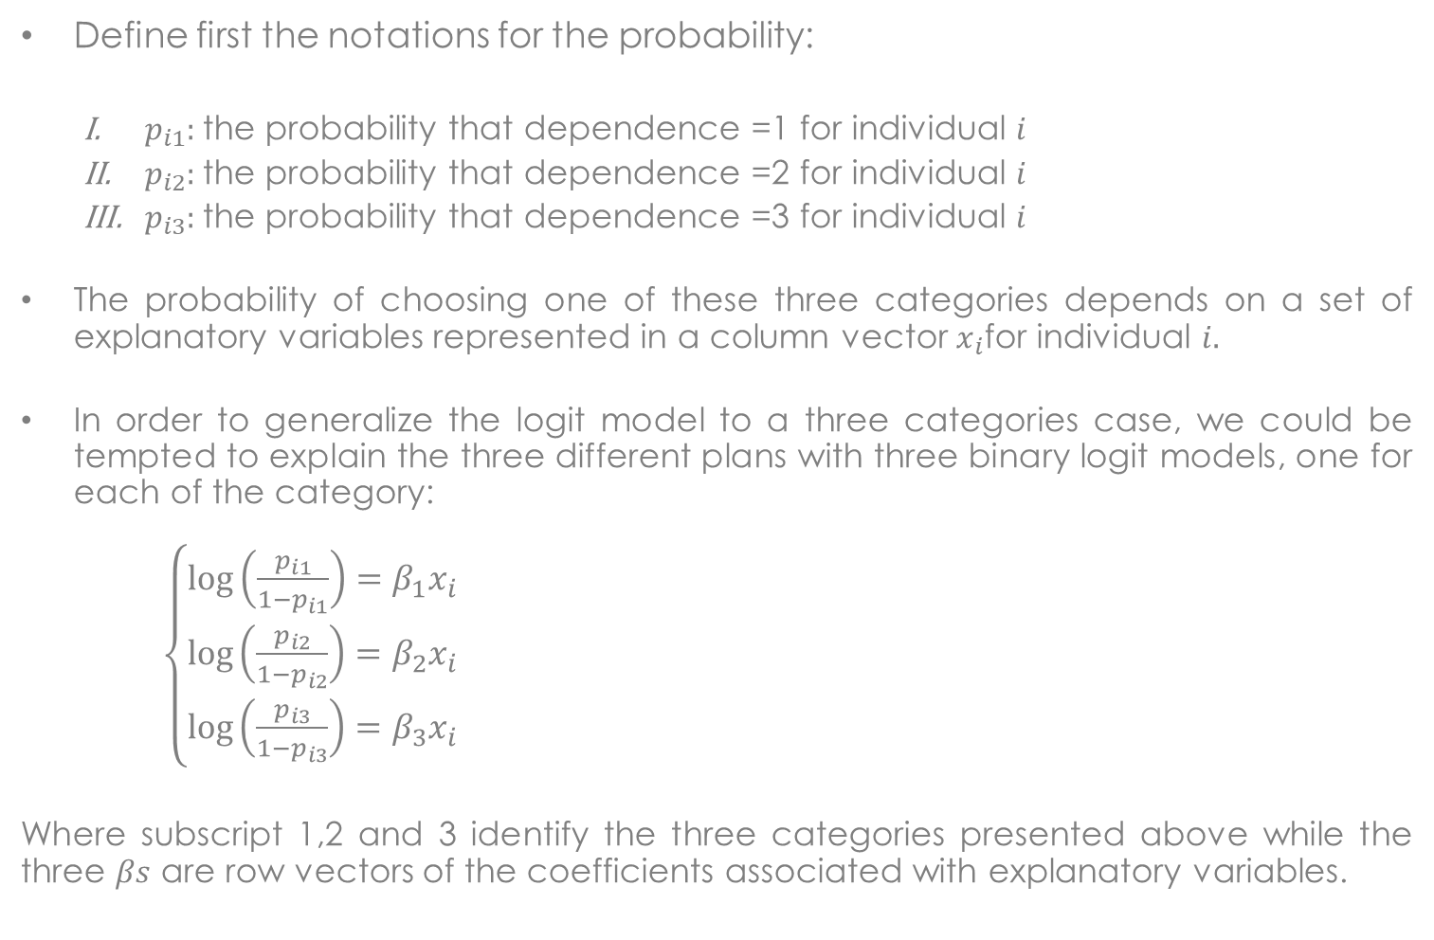
Multinomial logit Model: basic notations
Define first the notations for the probability:
$p_{i1}:$the probability that dependence =1 for individual $i$
$p_{i2}:$the probability that dependence =2 for individual $i$
$p_{i3}:$the probability that dependence =3 for individual $i$
The probability of choosing one of these three categories depends on a set of explanatory variables represented in a column vector $x_{i}$for individual $i.$
In order to generalize the logit model to a three categories case, we could be tempted to explain the three different plans with three binary logit models, one for each of the category:
$\left\{\begin{aligned}\log\left(\frac{p_{i1}}{1−p_{i1}}\right)=β_{1}x_{i} \\ \log\left(\frac{p_{i2}}{1−p_{i2}}\right)=β_{2}x_{i} \\ \log\left(\frac{p_{i3}}{1−p_{i3}}\right)=β_{3}x_{i}\end{aligned}\right.$
Where subscript 1,2 and 3 identify the three categories presented above while the three $βs$ are row vectors of the coefficients associated with explanatory variables.
Joseph Lanfranchi ISF 2021-22

Slide 11
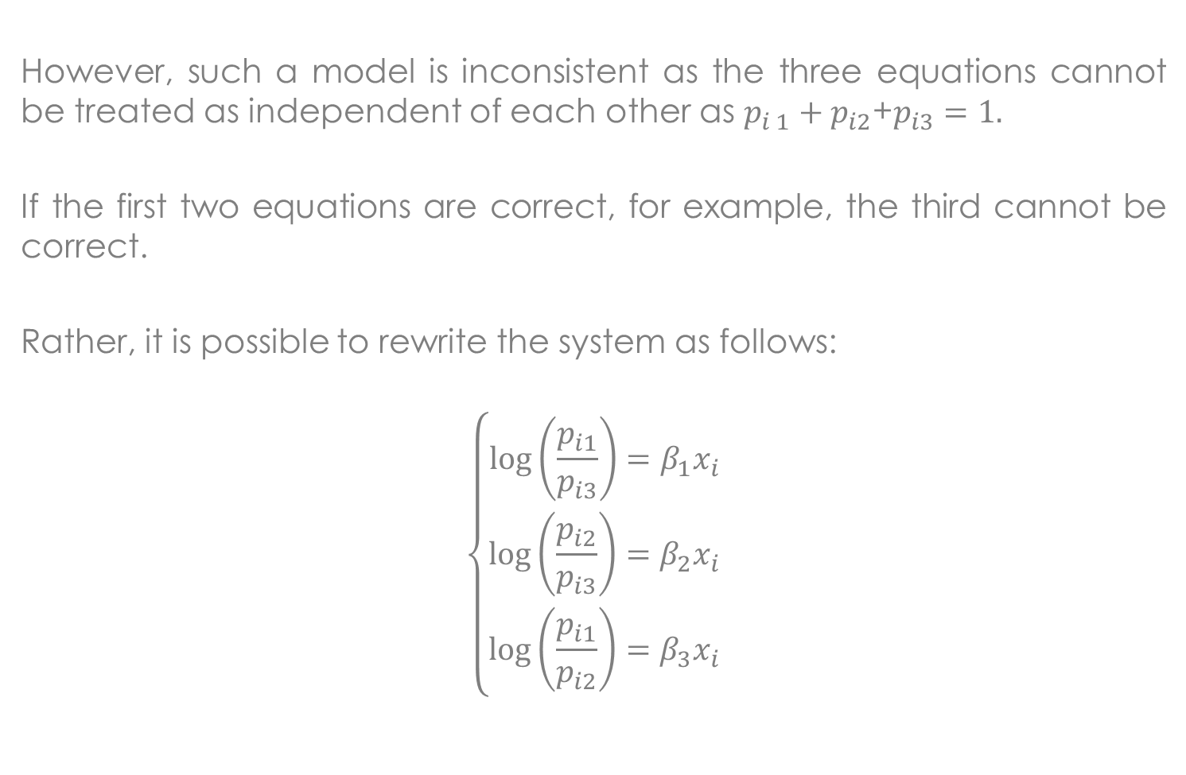
Multinomial logit Model: basic notations (II)
However, such a model is inconsistent as the three equations cannot be treated as independent of each other as $p_{i 1}+p_{i2}$+$p_{i3}=1.$
If the first two equations are correct, for example, the third cannot be correct.
Rather, it is possible to rewrite the system as follows:
$$\left\{\begin{aligned}\log\left(\frac{p_{i1}}{p_{i3}}\right)=β_{1}x_{i} \\ \log\left(\frac{p_{i2}}{p_{i3}}\right)=β_{2}x_{i} \\ \log\left(\frac{p_{i1}}{p_{i2}}\right)=β_{3}x_{i}\end{aligned}\right.$$
Joseph Lanfranchi ISF 2021-22

Slide 12

Multinomial logit Model: basic notations
These three equations are mutually consistent :
$$\log\left(\frac{p_{i1}}{p_{i2}}\right)=\log\left(\frac{p_{i1}}{p_{i3}}\right)−\log\left(\frac{p_{i2}}{p_{i3}}\right)=β_{1}x_{i}−β_{2}x_{i}$$
which implies that $β_{3}=β_{1}−β_{2}$. This property is central for the interpretation of effects.
Solving for the three probabilities we obtain the following system of equations:
$$\left\{\begin{aligned}p_{i1}=\frac{e^{β_{1}x_{i}}}{1+e^{β_{1}x_{i}}+e^{β_{2}x_{i}}} \\ p_{i2}=\frac{e^{β_{2}x_{i}}}{1+e^{β_{1}x_{i}}+e^{β_{2}x_{i}}} \\ p_{i3}=\frac{1}{1+e^{β_{1}x_{i}}+e^{β_{2}x_{i}}}\end{aligned}\right.$$
It is easy to verify that these three probabilities sum to1.
Joseph Lanfranchi ISF 2021-22

Slide 13
Multinomial logit Model: basic syntax
The most widely used method of estimation is the maximum likelihood estimation.
This estimation in Sas can be obtained with four procedures: LOGISTIC, SURVEYLOGISTIC, CATMOD and GLIMMIX but we will focus on the LOGISTIC procedure. The syntax changes from the logit model by the inclusion of the following option: / LINK= GLOGIT
Adding this condition, SAS understands that the variable named « dependance » takes more than two possible values but that this categorical variable cannot be estimated using a logit or probit model.
However, if we do not include this option, the program will understand that the response levels are ordered and will estimate the cumulative logit or ordered logit model. This cumulative model will be described in the next chapter.
Joseph Lanfranchi ISF 2021-22

Slide 14
Multinomial logit Model: output tables
Most of the output tables look alike those obtained from the logit model: first two tables describing the explained variable and the reference category; then a table with the statistics describing the goodness of fit of the model and finally one table with a test of the global null hypothesis according to which none of the explanatory variables would impact the choice of the dependency plans.
Moreover, the output display a “Type 3 Analysis of effects” table, that is an analysis of the effects of each explanatory variable on the outcome variable or the set of chosen categories.
Finally, as the distribution is logistic, two tables containing first the coefficient estimates associated with the set of explanatory variables for each choice category and second the estimated effects of the variables on the odds ratio.
Joseph Lanfranchi ISF 2021-22

Slide 15
Multinomial logit Model: lecture of output (I)
In the Type 3 Analysis of effects table, each Chi- square is a test of the null hypothesis that the explanatory variable has no effect on the outcome variable.
In this model, there are two degrees of freedom for each chi-square statistic as each variable is associated with two coefficients. Therefore, the null hypothesis states that both coefficients are simultaneously equal to zero.
In our model, only the variable dipsup, measuring that the respondent has continued education above the baccalaureate, seems identified as significantly explicative of the chosen dependency plans.
Analyse des effets Type 3
Effet | DDL | Khi-2 de Wald | Pr > Khi-2
age55 | 2 | 4.4134 | 0.1101
dipsup | 2 | 8.2955 | 0.0158
prev | 2 | 3.6985 | 0.1574
averse | 2 | 0.7516 | 0.6868
femme | 2 | 0.6915 | 0.7077
Joseph Lanfranchi ISF 2021-22

Slide 16
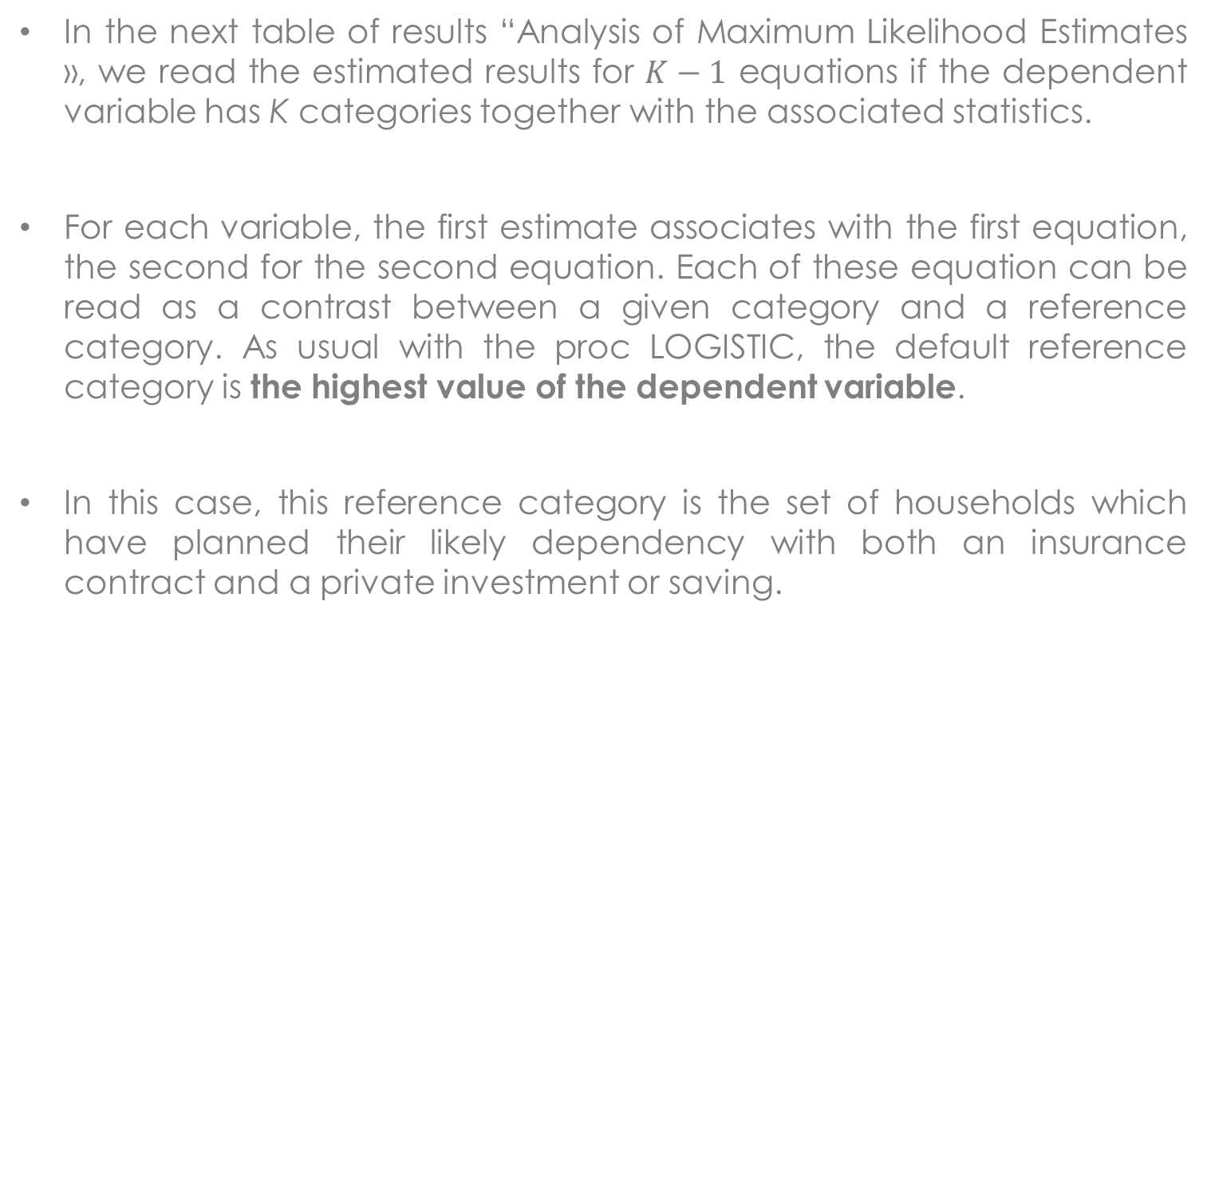
Multinomial logit Model: lecture of output (II)
In the next table of results “Analysis of Maximum Likelihood Estimates », we read the estimated results for $K−1$ equations if the dependent variable has K categories together with the associated statistics.
For each variable, the first estimate associates with the first equation, the second for the second equation. Each of these equation can be read as a contrast between a given category and a reference category. As usual with the proc LOGISTIC, the default reference category is the highest value of the dependent variable.
In this case, this reference category is the set of households which have planned their likely dependency with both an insurance contract and a private investment or saving.
Joseph Lanfranchi ISF 2021-22

Slide 17
Multinomial logit Model: lecture of output (III)
The reading of the results is not so easy. The first equation reports the estimates of a model for category 1 versus category 3, that is the choice of a dependency insurance contract versus using the two forms of dependency plans simultaneously.
The coefficient associated with a given explanatory variable in the first equation measures the effect of this variable on the probability of belonging to the first category rather than to the third.
Furthermore, it is impossible to directly read the effects of explanatory variables on the choices between the two categories out of the reference one, that are here categories 1 and 2.
Joseph Lanfranchi ISF 2021-22

Slide 18
Maximum Likelihood Estimates
Parameter | dependance | DDL | Estimation | Standard error | Wald Chi-Square | Pr > Chisq
Intercept | 1 | 1 | 2.7670 | 0.6641 | 17.3594 | <.0001
Intercept | 2 | 1 | 0.9337 | 0.7426 | 1.5810 | 0.2086
age55 | 1 | 1 | -1.1619 | 0.5764 | 4.0627 | 0.0438
age55 | 2 | 1 | -0.6792 | 0.6334 | 1.1498 | 0.2836
dipsup | 1 | 1 | -0.8706 | 0.4515 | 3.7182 | 0.0538
dipsup | 2 | 1 | 0.1993 | 0.4913 | 0.1646 | 0.6850
prev | 1 | 1 | -0.7998 | 0.4462 | 3.2124 | 0.0731
prev | 2 | 1 | -0.2810 | 0.5046 | 0.3101 | 0.5776
averse | 1 | 1 | 0.3492 | 0.4365 | 0.6397 | 0.4238
averse | 2 | 1 | 0.1418 | 0.5055 | 0.0787 | 0.7790
femme | 1 | 1 | -0.3310 | 0.3981 | 0.6912 | 0.4058
femme | 2 | 1 | -0.2480 | 0.4577 | 0.2935 | 0.5880

Slide 19
Multinomial logit Model: lecture of output
To make the reading easier, it is helpful to reorganize the output tables into separate columns each containing the estimates associated with the choice of a given category in comparison with a chosen reference.
In this case, the new table contains three columns, the first two being those from “Analysis of Maximum Likelihood Estimates » table while the last column corresponds to the estimates of an equation predicting the choice of category 1 rather than category 2.
The coefficients of the last column can be obtained by simply subtracting the estimated numbers of the second column from the estimated numbers in the first one.
Joseph Lanfranchi ISF 2021-22

Slide 20
Multinomial logit Model: lecture of output
Alternatively the numbers of column 3 are the results of the estimation of a model where the chosen reference is the category 2 for example. The estimates read in the new result table for the first equation are the effects of the variables of choosing the first category rather than the second.
This requires to add the option (REF='2') in the MODEL instruction.
This second method has the further advantage to estimate the standard deviations of the estimates end therefore to test their significance.
The third column has a dual interpretation: the estimates measures the effect of the explanatory variables to belong to the first category rather than to the second category, conditional on not belonging to the third category and the difference between the coefficients of the first two equations.
Joseph Lanfranchi ISF 2021-22

Slide 21
 | Insurance vs Insurance and Investment | Investment vs Insurance and Investment | Insurance vs Investment
Intercept | 2.7670*** | 0.9337 | 1.8333***
age55 | -1.1619** | -0.6792 | -0.4827
dipsup | -0.8706* | 0.1993 | -1.0699***
prev | -0.7998* | -0.2810 | -0.5188
averse | 0.3492 | 0.1418 | 0.2073
femme | -0.3310 | -0.2480 | -0.0830

Slide 22

Multinomial logit Model: interpretation of odds
It remains simpler, as for the logit model, to interpret the results just as odds ratio, except that they describe conditional odds.
For example, in the estimated model with category 3 as the reference one, the estimated odds ratio for the variable age55 is 0,313. That means that the odds that an individual older than 55 years possesses a dependency insurance contract and has privately invested rather than possess only an insurance contract is about 3,2 (inverse of 0,313) times the odds for people less than 55, conditional on not having only Private investments and savings.
Identically, we can infer from the results that far-sighted head of households have an odds of using both plans of prevention rather than only an insurance contract that is about 2,2 the odds (inverse of 0,449) for the non foresighted household, conditional on not having only Private investments and savings. However this effect is here not significant at 5%.
We can state the same result saying that the foresighted households have an odds of possessing only a dependency insurance contract rather than the two prevention plans that is a little bit less than half the odds (0,449) for the non foresighted households.
Joseph Lanfranchi ISF 2021-22

Slide 23
Odds Ratio Estimates
Effect | dependance | Point estimate | 95% Wald Confiance Limits
age55 | 1 | 0.313 | 0.101 | 0.968
age55 | 2 | 0.507 | 0.147 | 1.755
dipsup | 1 | 0.419 | 0.173 | 1.014
dipsup | 2 | 1.221 | 0.466 | 3.197
prev | 1 | 0.449 | 0.187 | 1.078
prev | 2 | 0.755 | 0.281 | 2.030
averse | 1 | 1.418 | 0.603 | 3.336
averse | 2 | 1.152 | 0.428 | 3.104
femme | 1 | 0.718 | 0.329 | 1.567
femme | 2 | 0.780 | 0.318 | 1.914

Slide 24
Odds Ratio Estimates
Effect | dependance | Point estimate | 95% Wald Confiance Limits
age55 | 1 | 0.617 | 0.258 | 1.479
age55 | 3 | 1.972 | 0.570 | 6.826
dipsup | 1 | 0.343 | 0.156 | 0.753
dipsup | 3 | 0.819 | 0.313 | 2.146
prev | 1 | 0.595 | 0.262 | 1.354
prev | 3 | 1.324 | 0.493 | 3.560
averse | 1 | 1.230 | 0.571 | 2.650
averse | 3 | 0.868 | 0.322 | 2.337
femme | 1 | 0.920 | 0.460 | 1.840
femme | 3 | 1.281 | 0.523 | 3.143

Slide 25
Multinomial logit Model: tests of equality
With the TEST instruction, it is possible to perform linear test of equality between estimated coefficient just like in the logit model, with the possibility to differentiate the estimated coefficients by equation or chosen category.
For example, one can test, within the same category of households, if the coefficients associated with foresight and risk aversion are equal.
Further, we can also test the null hypothesis that the estimated coefficients associated with the variables age55, dipsup and prev are simultaneously equal in the two columns 1 and 2, or put differently if these variables have the same effect on the probability to chose category 1 and 2.
Finally, we can test the null hypothesis that all the coefficients measuring the effects on the probability to chose one category are identical to the corresponding coefficients measuring the effects on the probability to chose another category, with an identical reference category.
To perform this test, we should identify the coefficient associated with a given variable for one category. Hence this is done by using the variable name adding _1 if it measures the effect on the choice by category denoted as 1. In our program, we add suffixes 1 and 2 for the categories of the variable « dependence » 1 and 2.
Joseph Lanfranchi ISF 2021-22

Slide 26
Multinomial logit Model: tests of equality (2)
The first test reveals that the effects of variables prev and averse on the probability to buy a dependency insurance contract rather that such a contract and to privately invest are not significantly different.
Chi-2
Libellé de Wald DDL Pr > Chi-2
Test 1 2.5092 1 0.1132
The third and fourth TEST instructions evaluate if all pairs of coefficients are equal when considering the choice of category 1 or 2, vs 3 as reference, or the choice of category 2 or 3 vs 1 as reference.
For the first question, the test concludes that the estimated coeff in category 1 and 2 are not the same, or different:
Chi-2
Libellé de Wald DDL Pr > Chi-2
Test 1 9.8122 5 0.0807
Joseph Lanfranchi ISF 2021-22

Slide 27
Multinomial logit Model: tests of equality (3)
For the second, however, there is no apparent difference in the behaviour of households when considering their choices between categories 2 and 3:
Chi-2
Libellé de Wald DDL Pr > Chi-2
Test 1 2.3975 5 0.7918
As this test had produced a high p-value, it would suggest that categories 2
and 3 of Dependence could be combined into a single category.
Joseph Lanfranchi ISF 2021-22

Slide 28
Multinomial logit: global significance
To evaluate if the model fits the data, the best way would be to consider how the model might be wrong or could be improved.
First, it is possible to allow interactions among the predictors in their effects on dependence.
Second, the continuous explanatory variables can be included in the estimated model through a polynomial form. Hence, the marginal effects of a continuous variable on the choice of various categories could be different at different value of the variable.
In a first step, we can use the goodness of fit statistics that are the deviance and Pearson Chi-Square, using the options AGGREGATE and SCALE=NONE.
Joseph Lanfranchi ISF 2021-22

Slide 29
Multinomial logit: global significance
In our model, The deviance and Pearson chi-square statistics have very high p-values, suggesting that the model fits the data quite well.
In our results, there exists 26 unique profiles, which is the number of unique combinations of the values of the explanatory variables. With 231 total cases, we have an average of 8.5 cases per profile.
It has to be noticed that when the number of cases per profile gets too small, these tests tend to produce inaccurate values of the deviance and Pearson statistics.
It is then necessary to examine the expected and observed frequencies in each profiles in a contingency table.
Joseph Lanfranchi ISF 2021-22

Slide 30
MML: expected frequencies of profiles
It is possible to obtain the expected frequencies of the profiles while producing a contingency table from the predicting probabilities of being in each of the three categories of the variable dependence.
With the option PREDPROBS=I, the program creates three new variables IP_1, IP_2 et IP_3 for each household measuring the predicted probability to belong to the three categories. In each profile, the sum of these probabilities will give the expected number of observations, the expected frequency.
In this table, in 48 cases out of 96, the expected frequencies are less than 2 and in 24 cases less than 1. This does not augur very well for the performance of the goodness of fit statistics.
A more direct approach is to test for the presence of significant interactions of variables by including them in the model.
Improvement of the model fit can be judged through testing if the estimated coefficients associated with the interactions of variables are significant or testing how different are the log likelihood ratio of the models with and without interaction terms.
Joseph Lanfranchi ISF 2021-22

Slide 31
Plots of predicted values
The statement EFFECTPLOT can be very helpful in visualizing the effect of a variable in a multinomial logit model.
The statement helps to get a plot of the predicted probabilities of falling into each of the three outcome categories as a function of values of each explanatory variable.
For such type of plots, the other variables are held at their means.
In the following graphs, the inclusion of the data point markers in the graph are suppressed by the NOOBS option while the NOLIMITS option get rid of the 95% confidence bands around the plot of the probability curve.
Joseph Lanfranchi ISF 2021-22

Slide 32
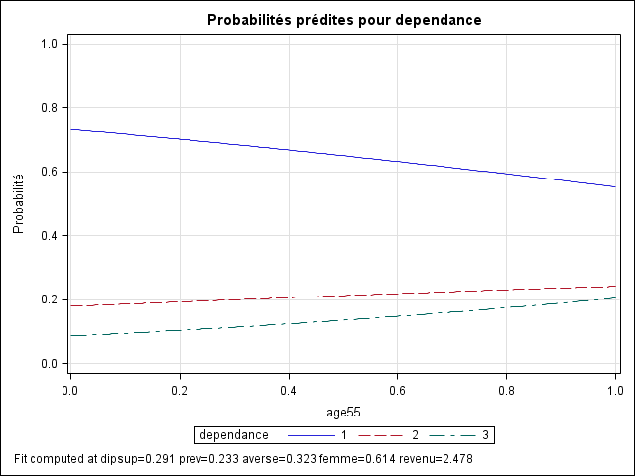

Slide 33
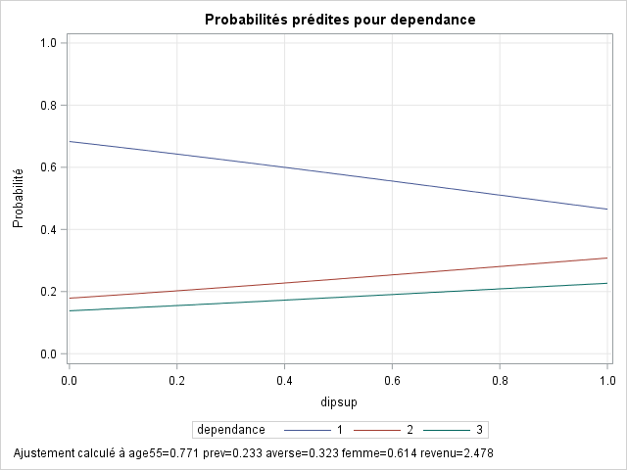

Slide 34
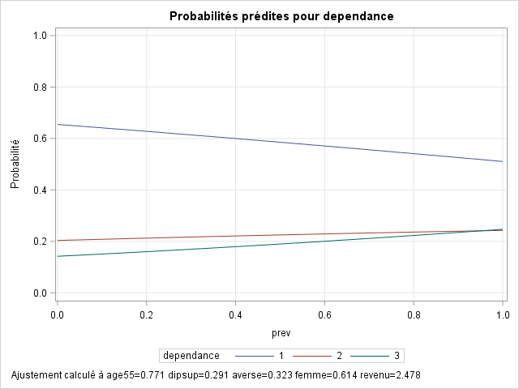

Slide 35
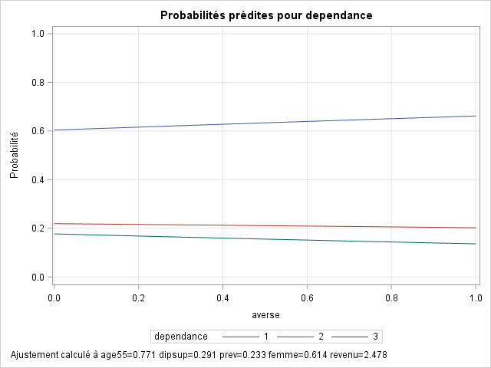

Slide 36
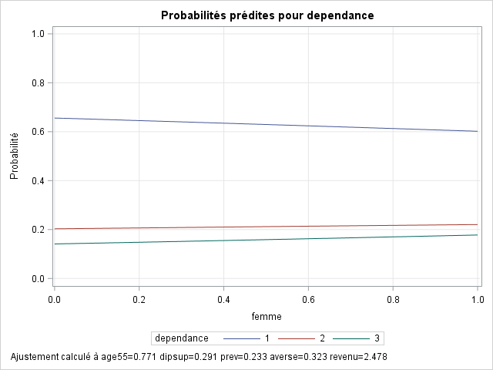

Slide 37
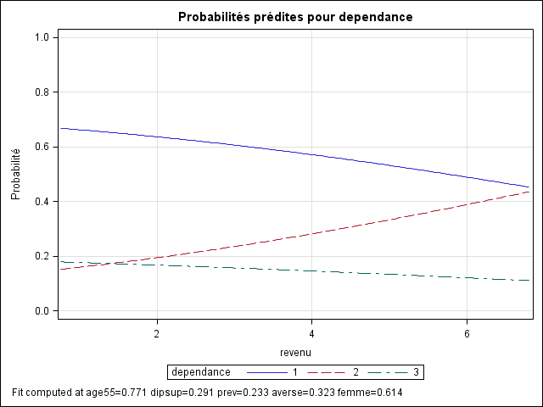

Slide 38
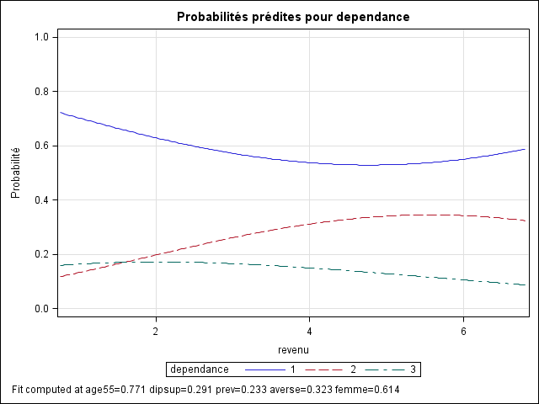

Slide 39
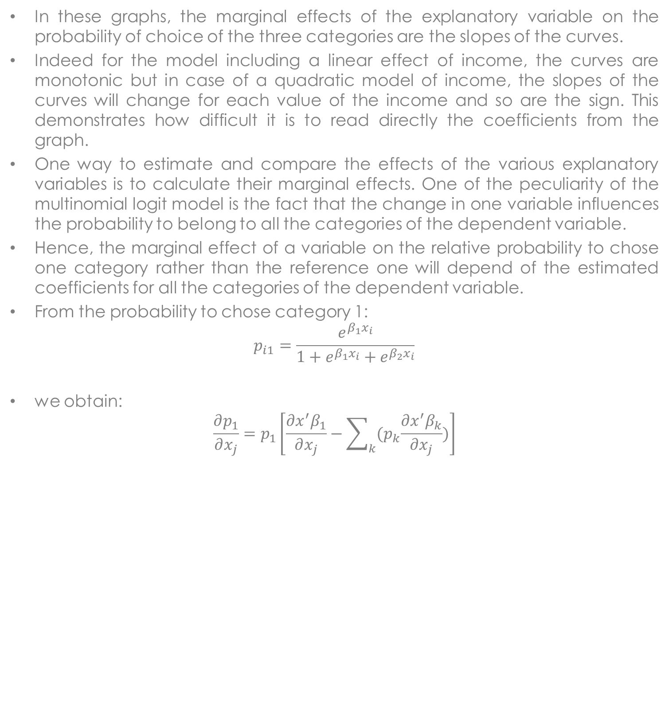
Marginal effects
In these graphs, the marginal effects of the explanatory variable on the probability of choice of the three categories are the slopes of the curves.
Indeed for the model including a linear effect of income, the curves are monotonic but in case of a quadratic model of income, the slopes of the curves will change for each value of the income and so are the sign. This demonstrates how difficult it is to read directly the coefficients from the graph.
One way to estimate and compare the effects of the various explanatory variables is to calculate their marginal effects. One of the peculiarity of the multinomial logit model is the fact that the change in one variable influences the probability to belong to all the categories of the dependent variable.
Hence, the marginal effect of a variable on the relative probability to chose one category rather than the reference one will depend of the estimated coefficients for all the categories of the dependent variable.
From the probability to chose category 1:
$$p_{i1}=\frac{e^{β_{1}x_{i}}}{1+e^{β_{1}x_{i}}+e^{β_{2}x_{i}}}$$
we obtain:
$$\frac{∂p_{1}}{∂x_{j}}=p_{1}\left[\frac{∂x^{′}β_{1}}{∂x_{j}}−\sum_{k}{{(p}_{k}\frac{∂x^{′}β_{k}}{∂x_{j}}})\right]$$
Joseph Lanfranchi ISF 2021-22

Slide 40
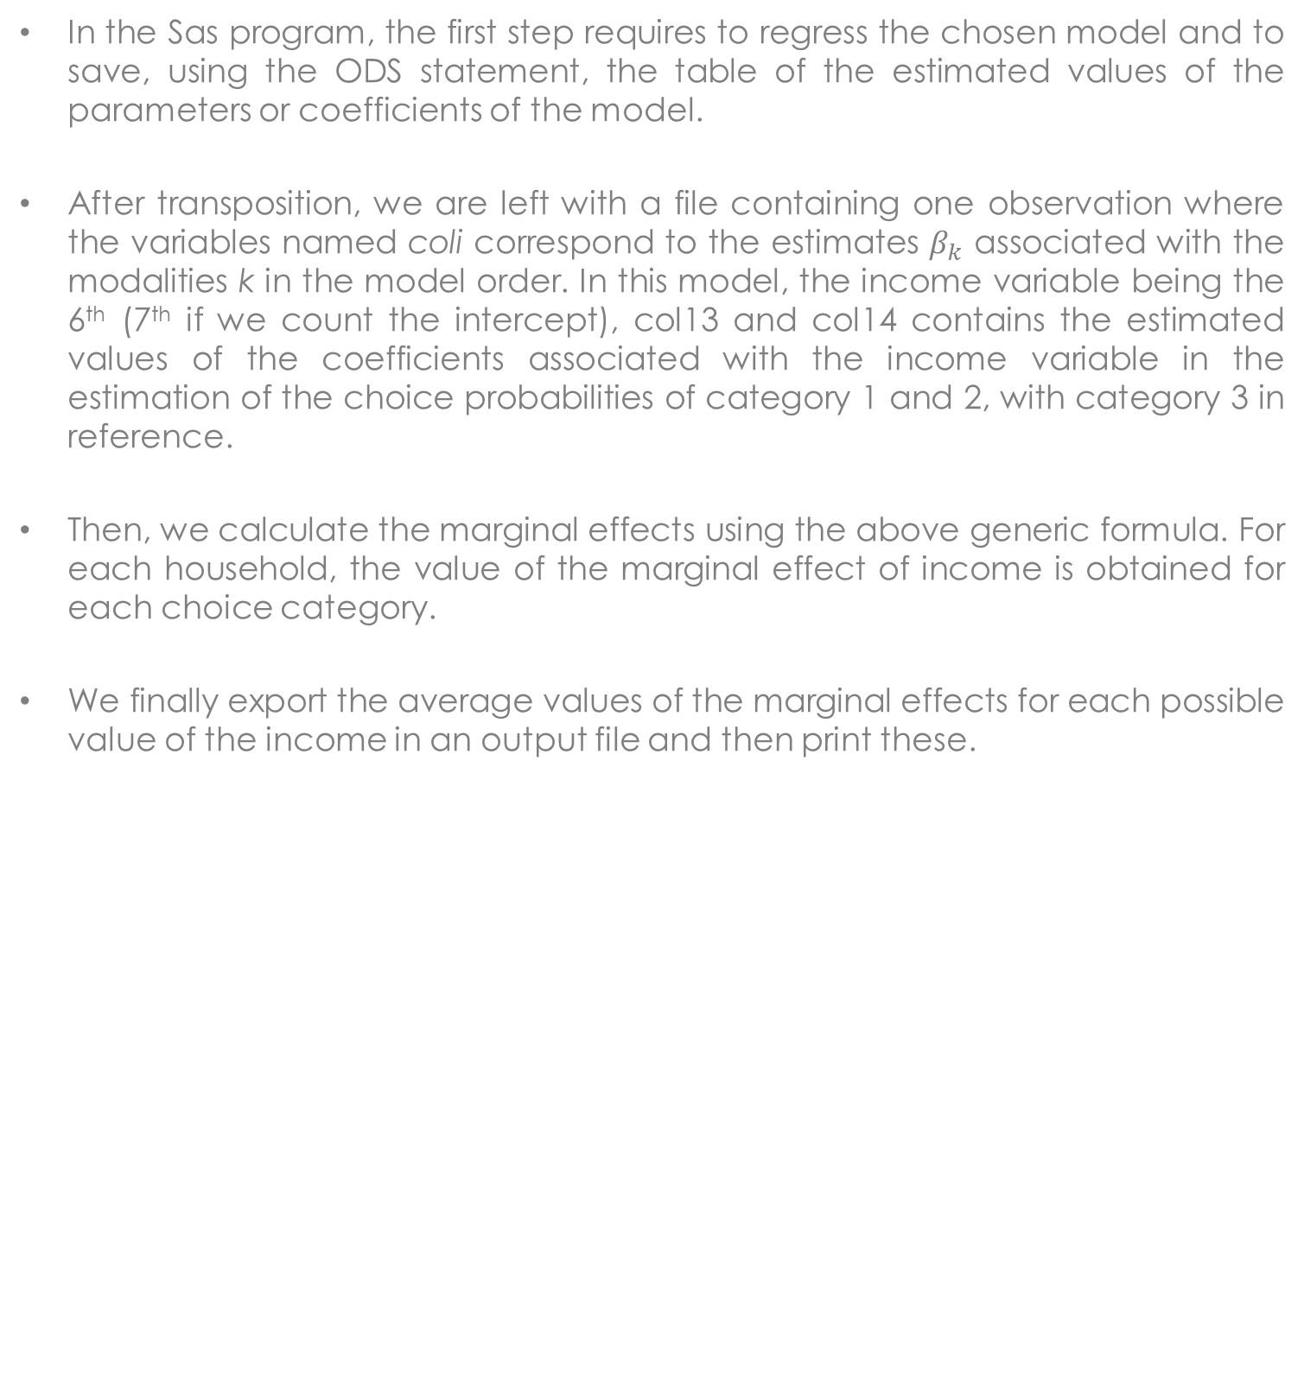
Marginal effects (2)
In the Sas program, the first step requires to regress the chosen model and to save, using the ODS statement, the table of the estimated values of the parameters or coefficients of the model.
After transposition, we are left with a file containing one observation where the variables named coli correspond to the estimates $β_{k}$ associated with the modalities k in the model order. In this model, the income variable being the 6th (7th if we count the intercept), col13 and col14 contains the estimated values of the coefficients associated with the income variable in the estimation of the choice probabilities of category 1 and 2, with category 3 in reference.
Then, we calculate the marginal effects using the above generic formula. For each household, the value of the marginal effect of income is obtained for each choice category.
We finally export the average values of the marginal effects for each possible value of the income in an output file and then print these.
Joseph Lanfranchi ISF 2021-22

Slide 41
Average marginal effects for income values
income | ME1rev | ME2rev | ME3rev
0.75 | -0.019561 | 0.025667 | -0.006106
1.05 | -0.020589 | 0.029982 | -0.009393
1.35 | -0.022355 | 0.030856 | -0.008500
1.70 | -0.025252 | 0.035442 | -0.010190
2.10 | -0.026455 | 0.038557 | -0.012101
2.50 | -0.028596 | 0.040784 | -0.012189
2.90 | -0.030322 | 0.042693 | -0.012371
3.40 | -0.032496 | 0.044933 | -0.012437
4.55 | -0.037895 | 0.053288 | -0.015394
6.80 | -0.043870 | 0.058134 | -0.014264

Slide 42
Average marginal effects for income values (quadratic profile)
income | ME1rev | ME2rev | ME3rev
0.75 | -0.066715 | 0.048957 | 0.017758
1.05 | -0.071733 | 0.056876 | 0.014858
1.35 | -0.068287 | 0.058403 | 0.009884
1.70 | -0.068073 | 0.064522 | 0.003551
2.10 | -0.060555 | 0.064680 | -0.004125
2.50 | -0.054510 | 0.063129 | -0.008619
2.90 | -0.045762 | 0.058717 | -0.012955
3.40 | -0.035007 | 0.051441 | -0.016434
4.55 | -0.006397 | 0.030001 | -0.023604
6.80 | 0.055457 | -0.032730 | -0.022728

Slide 43
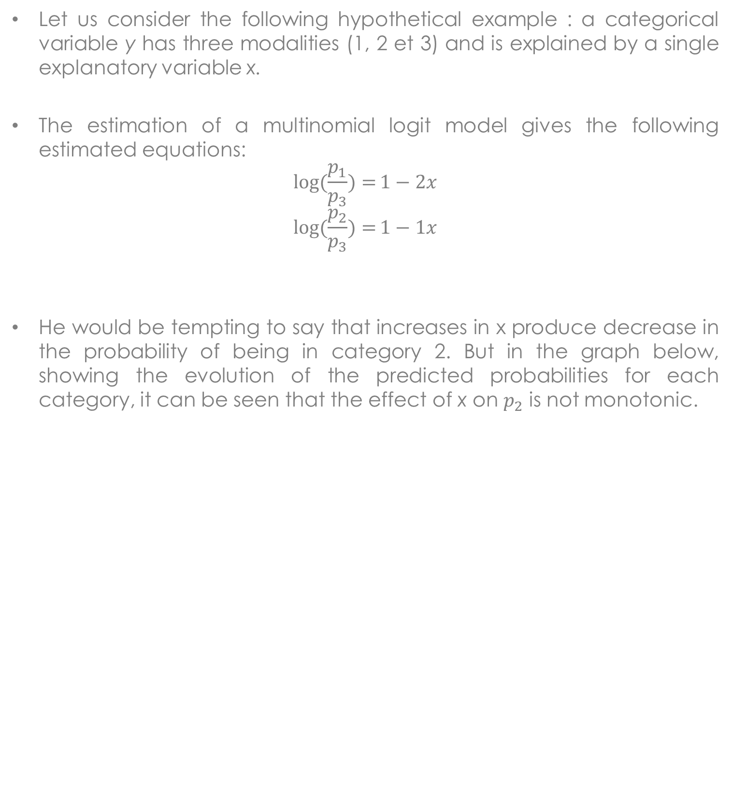
Likely mistakes of effects interpretation
Let us consider the following hypothetical example : a categorical variable y has three modalities (1, 2 et 3) and is explained by a single explanatory variable x.
The estimation of a multinomial logit model gives the following estimated equations:
$$\log{(\frac{p_{1}}{p_{3}})=}1−2x$$
$$\log{(\frac{p_{2}}{p_{3}})=}1−1x$$
He would be tempting to say that increases in x produce decrease in the probability of being in category 2. But in the graph below, showing the evolution of the predicted probabilities for each category, it can be seen that the effect of x on $p_{2}$ is not monotonic.
Joseph Lanfranchi ISF 2021-22

Slide 44
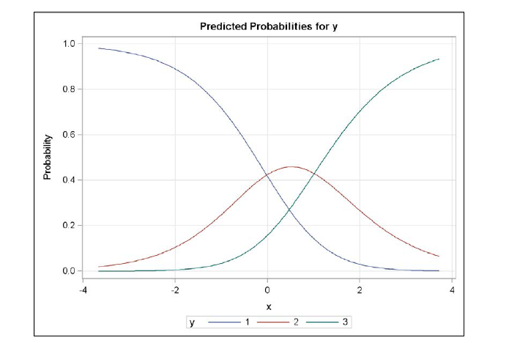

Slide 45

Likely mistakes of effects interpretation
On the graph, when x is below 0.5, an increase in x produces an increase in $p_{2}$, but when x is above 0,5 increases in x produce decreases in $p_{2}!$
The structure of the estimated model implies that an increase in x move individuals from category 2 to category 3, but at the same time should move individuals from category 1 to category 2.
When x is low, most of the individuals are in category 1, so most of the movement is from 1 to 2 and the proportion of cases in 2 increases. Nevertheless, as there are few cases left in category 1, most of the movement are then from 2 to 3, and the proportion in 2 declines.
Hence, multinomial logit coefficients must always be interpreted as effects of comparison between pairs of categories of choice, but never on the probability of being in a particular category.
Joseph Lanfranchi ISF 2021-22

Slide 46
Estimation with multiple logit models (1)
As it is possible to interpret multinomial logit model as of binary logit equations, Begg and Gray (1984) have shown that you can estimate the multinomial logit model by running a set of binary logit models.
Asymptotic properties of the estimates using binary logit models together with those of the predicted choice probabilities are quite high. The method just requires to exclude the households that fall into category not considered in the binary logit model.
Hence, in the program:
proc logistic data=patermulti;
where dependance NE 2;
model dependance = age55 dipsup prev averse femme;
proc logistic data=patermulti;
where dependance NE 1;
model dependance = age55 dipsup prev averse femme;
proc logistic data=patermulti;
where dependance NE 3;
model dependance = age55 dipsup prev averse femme;
run;
By default, the reference category is still the highest value for the dependent variable.
Joseph Lanfranchi ISF 2021-22

Slide 47
 | Insurance vs Insurance and Investment | Investment vs Insurance and Investment | Insurance vs Investment
Intercept | 2.7550*** | 0.9761 | 1.7567***
age55 | -1.1678** | -0.7361 | -0.4094
dipsup | -0.9131** | 0.1684 | -1.0244***
prev | -0.8107* | -0.3615 | -0.4988
averse | 0.2732 | 0.2831 | 0.1974
femme | -0.2419 | -0.2523 | -0.0741
Comparing this table with the table in slide #19, we observe that the coefficients are very similar but not perfectly identical. The significance remains also very stable although the p value of the variable DIPSUP is now below 5%.
Joseph Lanfranchi ISF 2021-22

Slide 48
Estimation with multiple logit models (2)
The coefficients are unbiased but their standard deviation are somewhat larger.
Furthermore, the third column of the above table is not exactly similar to the difference between the first two.
Finally, estimation by binary logit will not give a global test of whether all coefficients associated with a variable are equal to zero.
It can be useful to perform such an analysis, especially when you have different sets of explanatory variables in different equations. However the main payoff is conceptual: it helps to understand that the multinomial logit is built up of binomial models.
Joseph Lanfranchi ISF 2021-22

